Slide 1

Multimedia security and privacy
Section 2

Slide 2
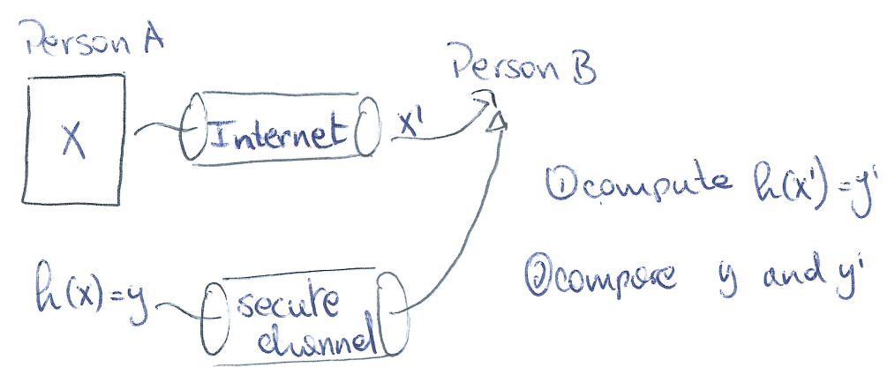
(2.1) Explain the main differences between content fingerprinting (robust perceptual hashing) and cryptographic hashing
A cryptographic function has the following properties:
Noted: h(X) = y
Input (X) is a binary string of any length (padding may be required)
Output (y) is a binary string of a given length
Changing a single bit in X, will change at least 50% of the bits of y
From y, it is impossible to find the corresponding X
It is computationally impossible to find collisions
Some hashing functions may require the use of keys
Usage: Integrity
(Authentication if key is used)

Slide 3
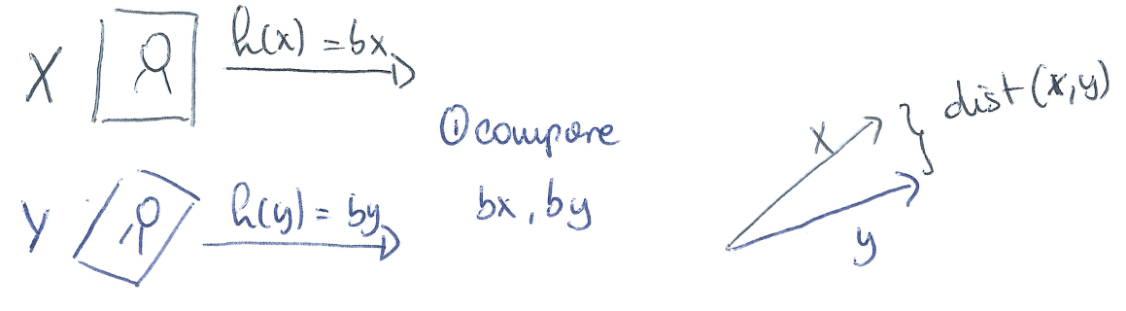
(2.1)
A content fingerprinting function has the following properties:
Noted: h(X) = bx
Input (X) is a binary string of any length (N)
Output (bx) is a binary string of a given length (L) => Short
Changing a single bit in X, will have small repercussions on y => Invariant
From y, it is impossible to find the corresponding X => Secure
Easy to find collisions
Some hashing functions may require the use of keys
Usage: Authentication and Identification

Slide 4
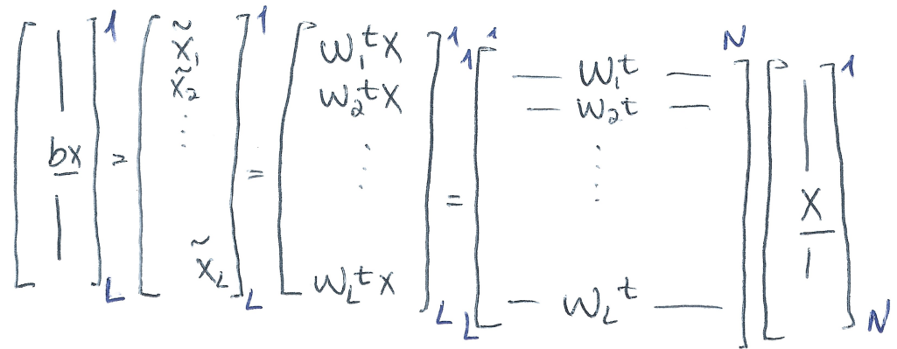
(2.1)
Levels of security
N >> L, since the hash is much smaller than the input data, it is impossible to recover X from bx. This also results in easy comparison between hashes.
Entropy of input: H(X) = N*H(Xi) = N*log2(256) = N*8
Entropy of output: H(bx) = L*H(bxi) = L*log2(2) = L*1 = L

Slide 5
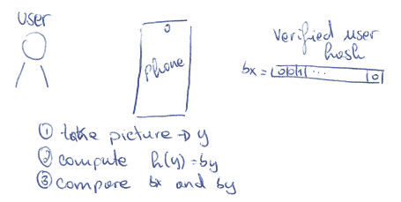
(2.2) Explain the main usage of content fingerprinting in various applications. What are the main advantages?
Main Usages: authentication and identification
Authentication:
Example: a phone that is able to unlock via face recognition, must take a snap picture of a user (that wants to unlock the phone). The phone must decide “is it a verified user, or not?”
=> yes or no question

Slide 6
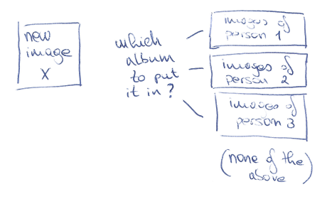
(2.2)
Identification:
Example: a phone keeps albums of images of each different person in its images. When taking a new picture, it needs to identify into which album the image must go.
=> Must decide which album, or none at all

Slide 7
(2.2)
Problems with doing these operations with the image itself:
Lets imagine we want to do both these operations with the image itself X
Let our image be of size N
In the authentication use case we need only to compare 2 images, each of size N => O(2*N) and O(N) (time/memory)
In the identification use case we need to compare to J albums (let’s assume each album has 1 image), every image of size N => O(J*N) and O(N*J) (time/memory)
Euclidean distance is a not a good measure of “likeness” in an image (not robust to geometrical operations)

Slide 8
(2.2)
If we instead compare the binary representation of each image bx, we get a certain number of advantages:
Speed and memory, as we can replace N by L (N >> L)
Vectors are binary, one can compute hamming distance instead of Euclidean distance
Secure in the event of data breaches (can’t recreate X from bx)
Robust to geometrical operations, compression
Follows known distribution (question 2.4)

Slide 9
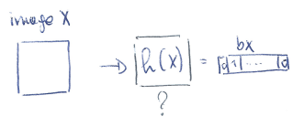
(2.3) Explain the construction of content fingerprinting function based on random projections and binarization
Recall:
Noted: h(X) = bx
Input (X) is a binary string of any length (N)
Output (bx) is a binary string of a given length (L)

Slide 10
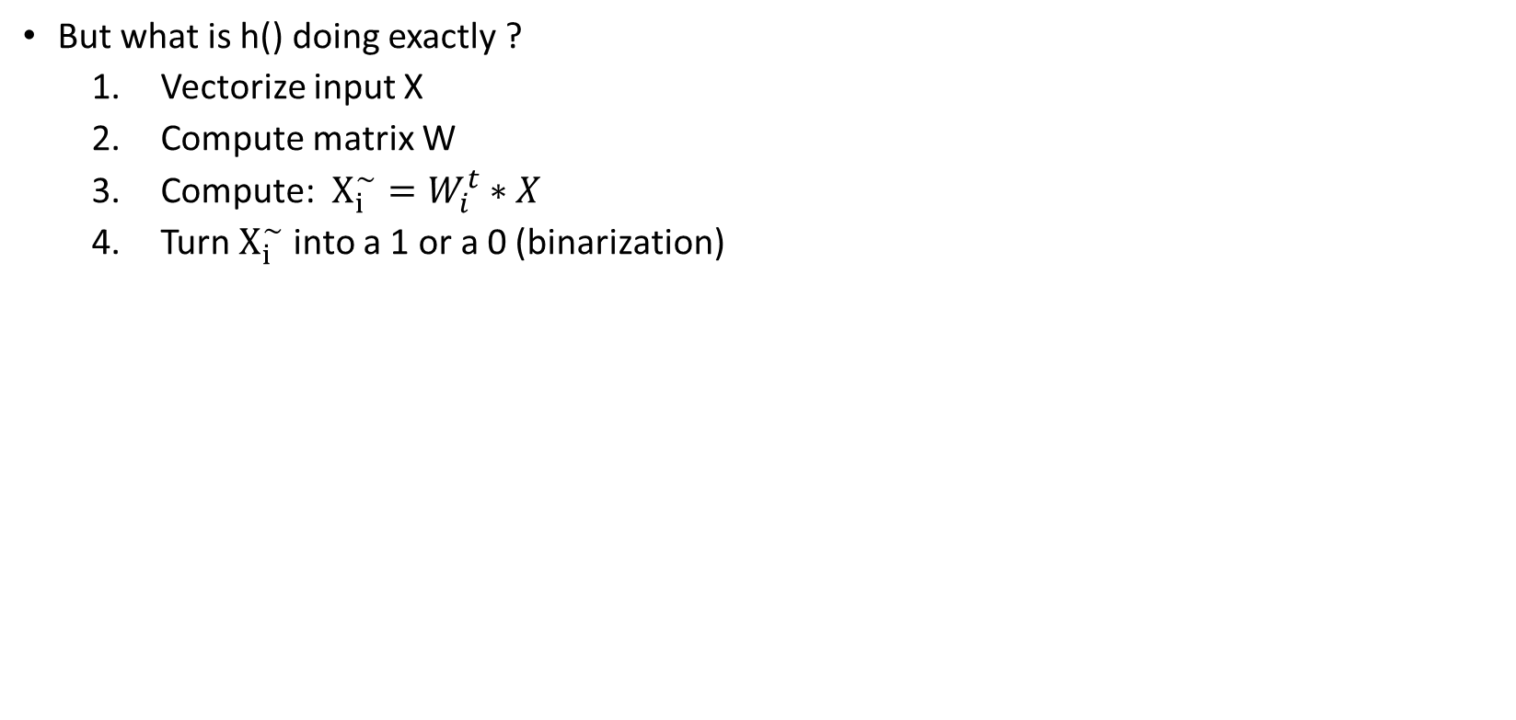
(2.3)
But what is h() doing exactly ?
Vectorize input X
Compute matrix W
Compute: $X_{i}^{\sim }=W_{i}^{t}∗X$
Turn $X_{i}^{\sim }$ into a 1 or a 0 (binarization)

Slide 11
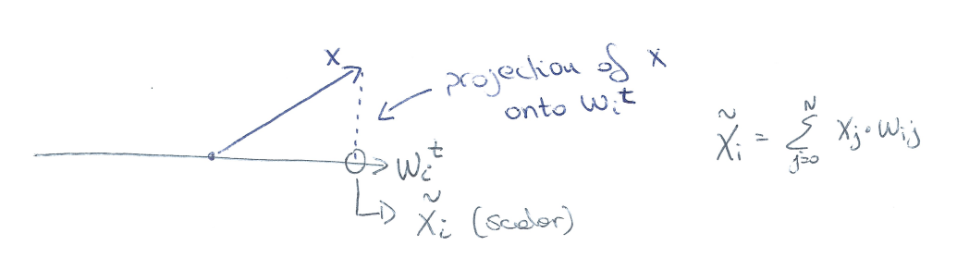
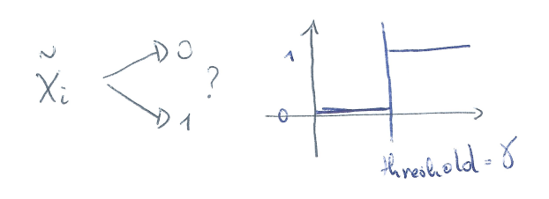
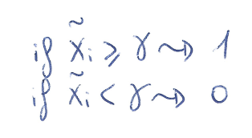
(2.3)
Projection:
Binarization:

Slide 12
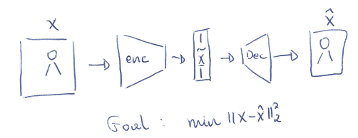
(2.3)
How do we compute matrix W ?
There are 2 possibilities, it is either handcrafted (HC), or machine learning (ML)
HC uses a secret key k, that it uses as a seed to generate random values for W, whoever has access to the key k, can compute the same matrix W
ML uses machine learning algorithms to create the perfect matrix W, no key required
Notes:
12

Slide 13
(2.3)
One question remains, which FP model is better ?
ML offers more robustness to geometrical operations/compression on X
ML needs training time to create a perfect encoder
ML is fully data dependant, meaning an attacker that has access to the data, can train his own model, and have a decoder
Both can be used, depending on the application one might be more appropriate!

Slide 14
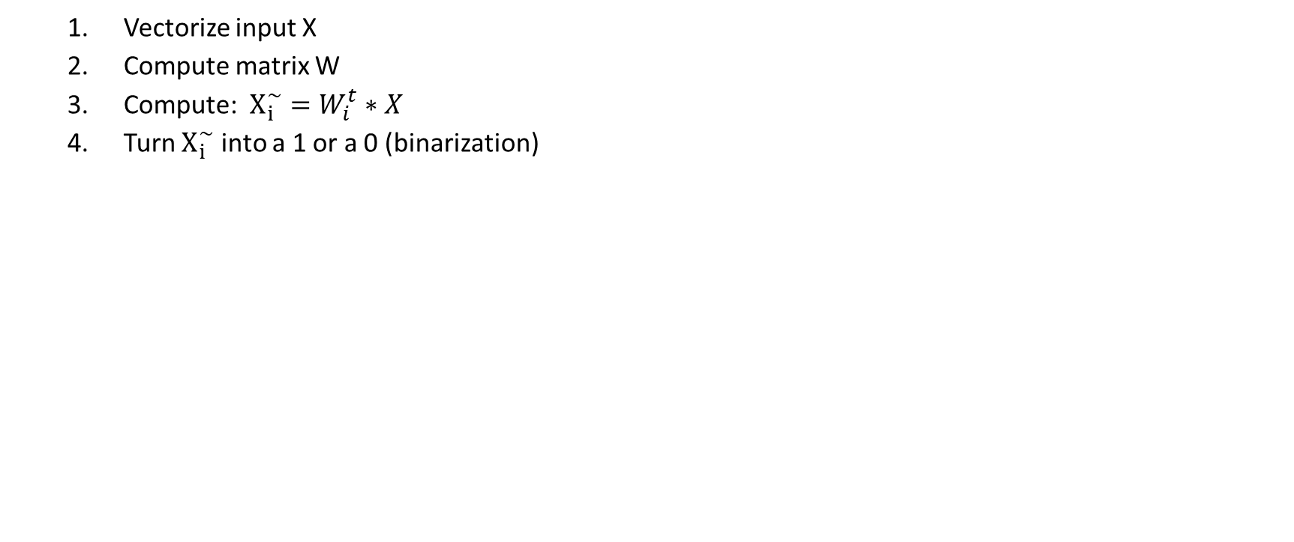
(2.4) Explain the statistics of coefficients under random projections used in content fingerprinting. Properties.
Vectorize input X
Compute matrix W
Compute: $X_{i}^{\sim }=W_{i}^{t}∗X$
Turn $X_{i}^{\sim }$ into a 1 or a 0 (binarization)

Slide 15
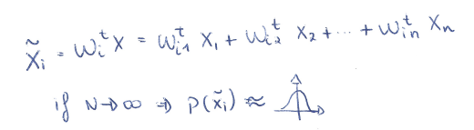
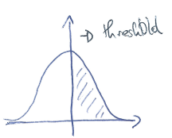
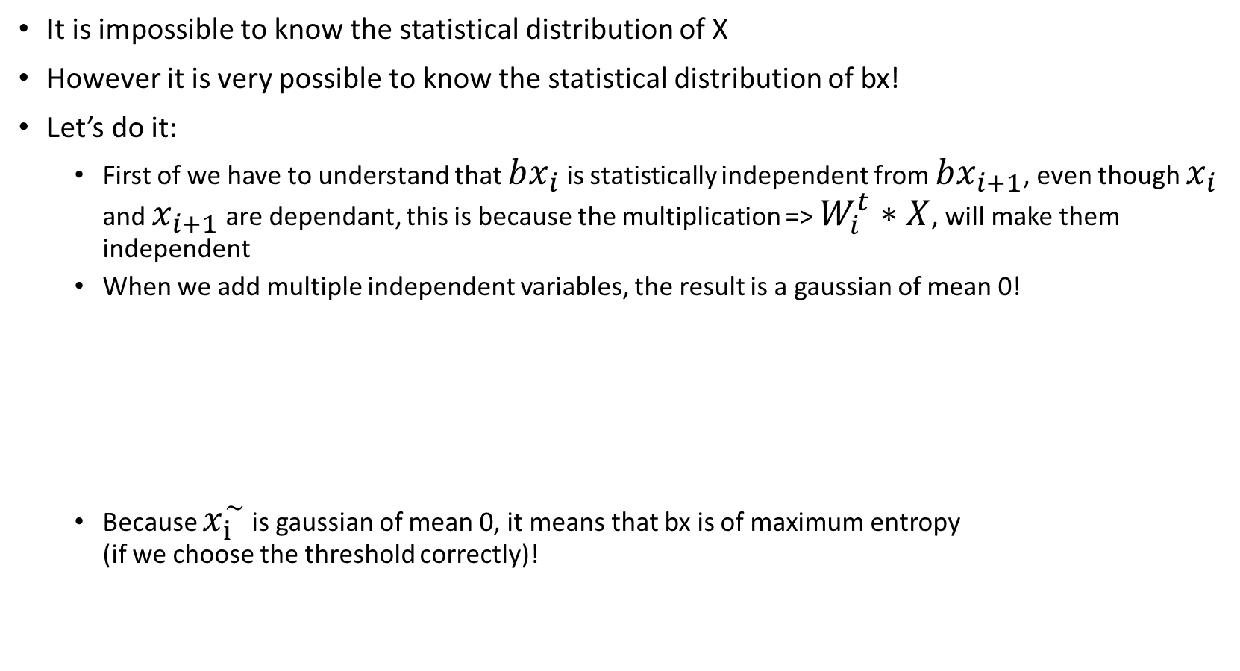
(2.4)
It is impossible to know the statistical distribution of X
However it is very possible to know the statistical distribution of bx!
Let’s do it:
First of we have to understand that $bx_{i}$ is statistically independent from $bx_{i+1}$, even though $x_{i}$ and $x_{i+1}$ are dependant, this is because the multiplication => $W_{i}^{t}∗X$, will make them independent
When we add multiple independent variables, the result is a gaussian of mean 0!
Because $x_{i}^{\sim }$ is gaussian of mean 0, it means that bx is of maximum entropy (if we choose the threshold correctly)!

Slide 16
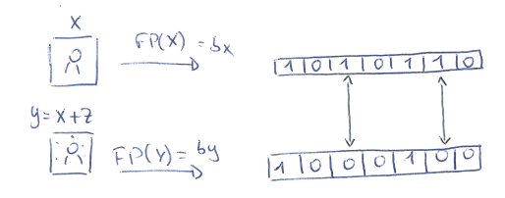
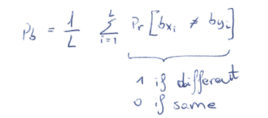
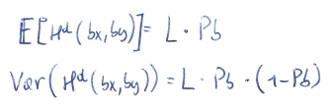
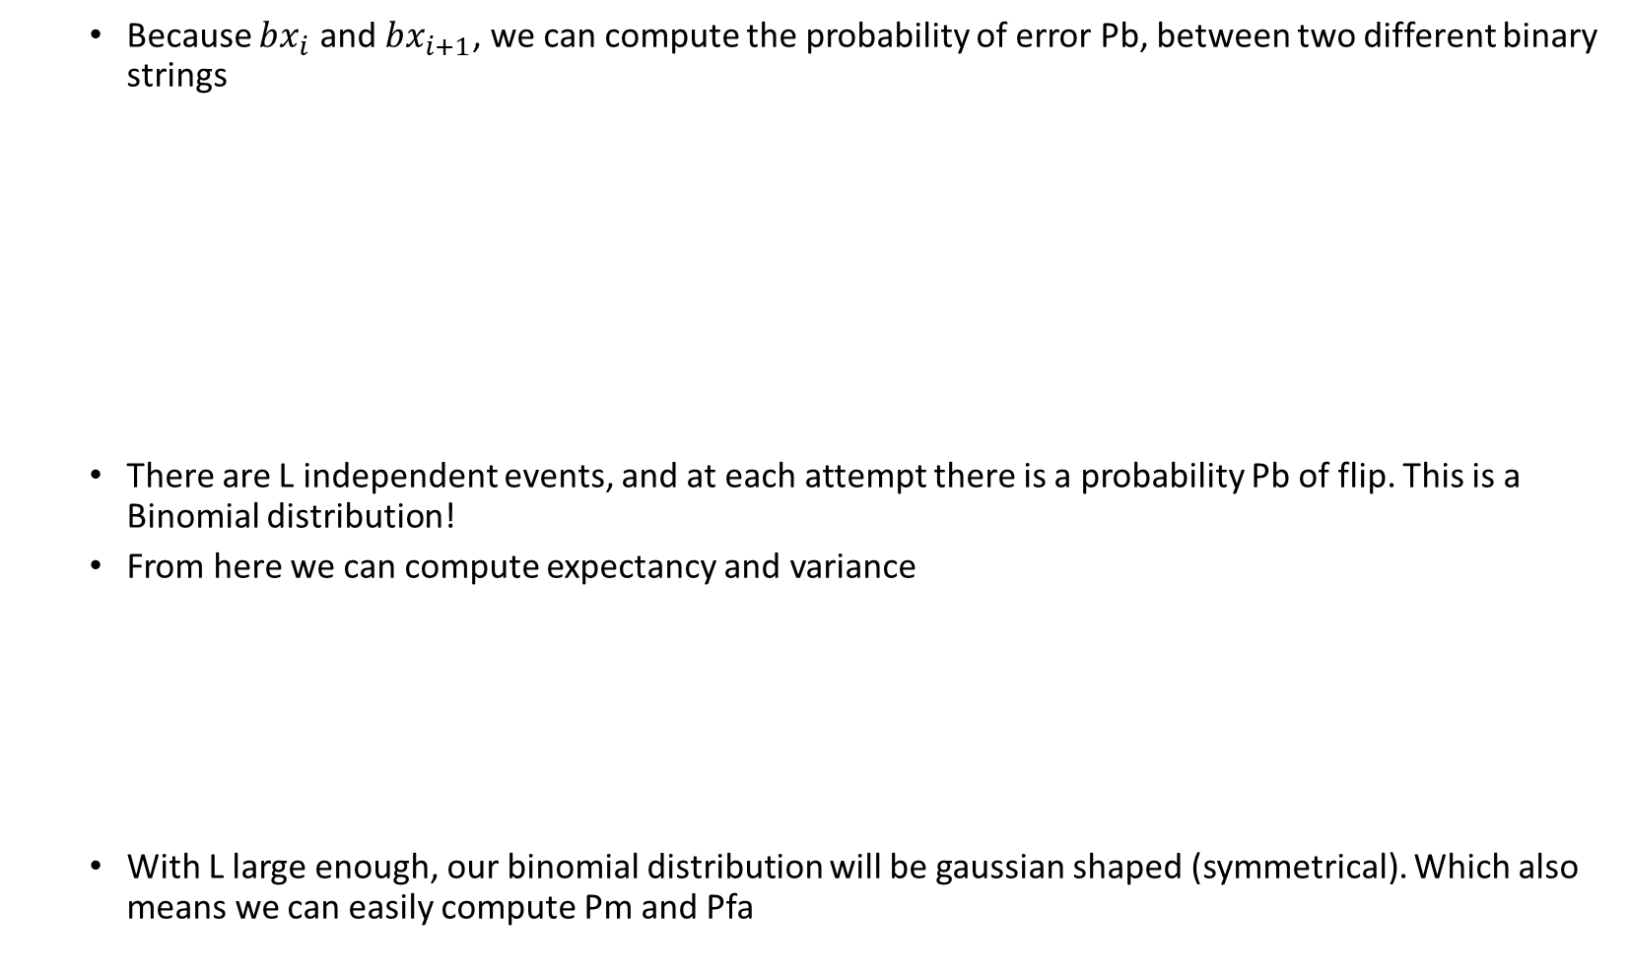
(2.4)
Because $bx_{i}$ and $bx_{i+1}$, we can compute the probability of error Pb, between two different binary strings
There are L independent events, and at each attempt there is a probability Pb of flip. This is a Binomial distribution!
From here we can compute expectancy and variance
With L large enough, our binomial distribution will be gaussian shaped (symmetrical). Which also means we can easily compute Pm and Pfa
Notes:
16

Slide 17
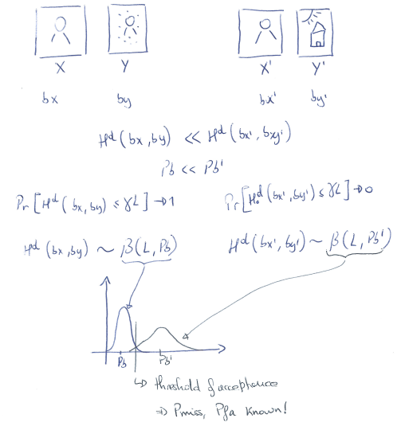
(2.4)

Slide 18
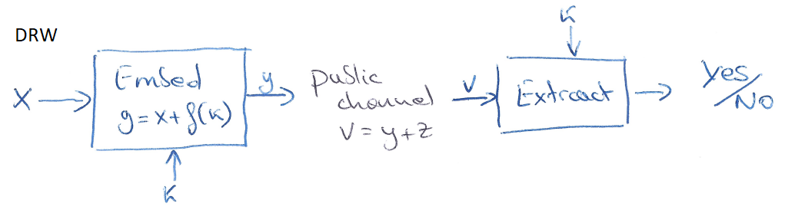
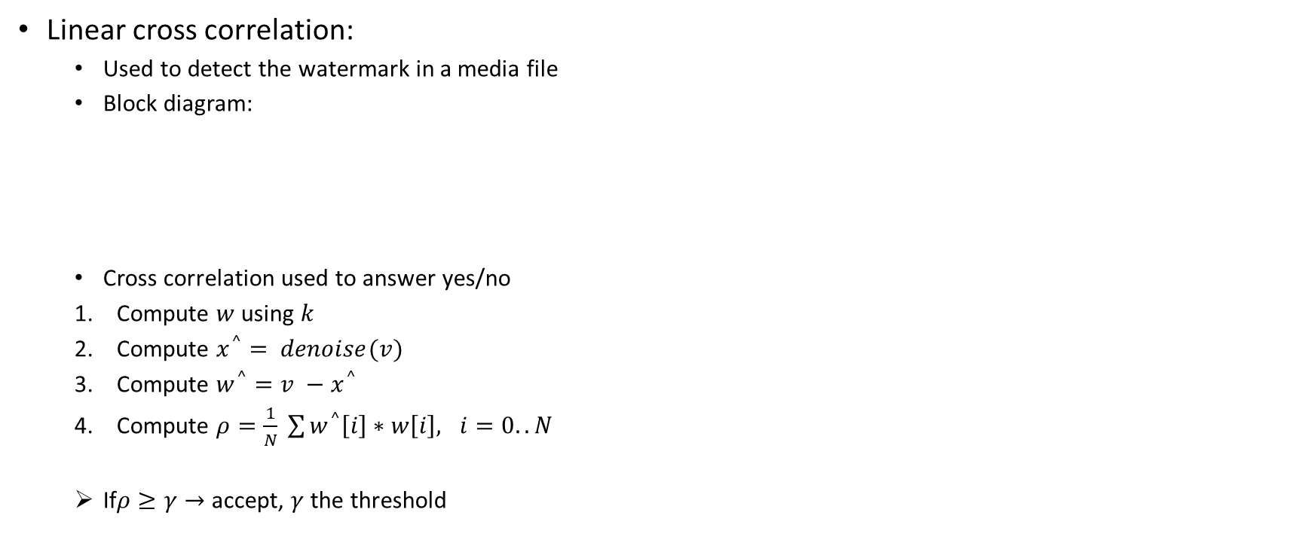
(2.5) Explain the difference between the sufficient statistics in digital watermarking (linear cross correlation) and Hamming distance? What are the implications of these differences?
Linear cross correlation:
Used to detect the watermark in a media file
Block diagram:
Cross correlation used to answer yes/no
Compute $w$ using $k$
Compute $x^{^}= denoise(v)$
Compute $w^{^}=v −x^{^}$
Compute $ρ=\frac{1}{N} \sum{w^{^}\left[i\right]∗w\left[i\right], i=0..N}$
If$ρ≥γ→$ accept, $γ$ the threshold

Slide 19
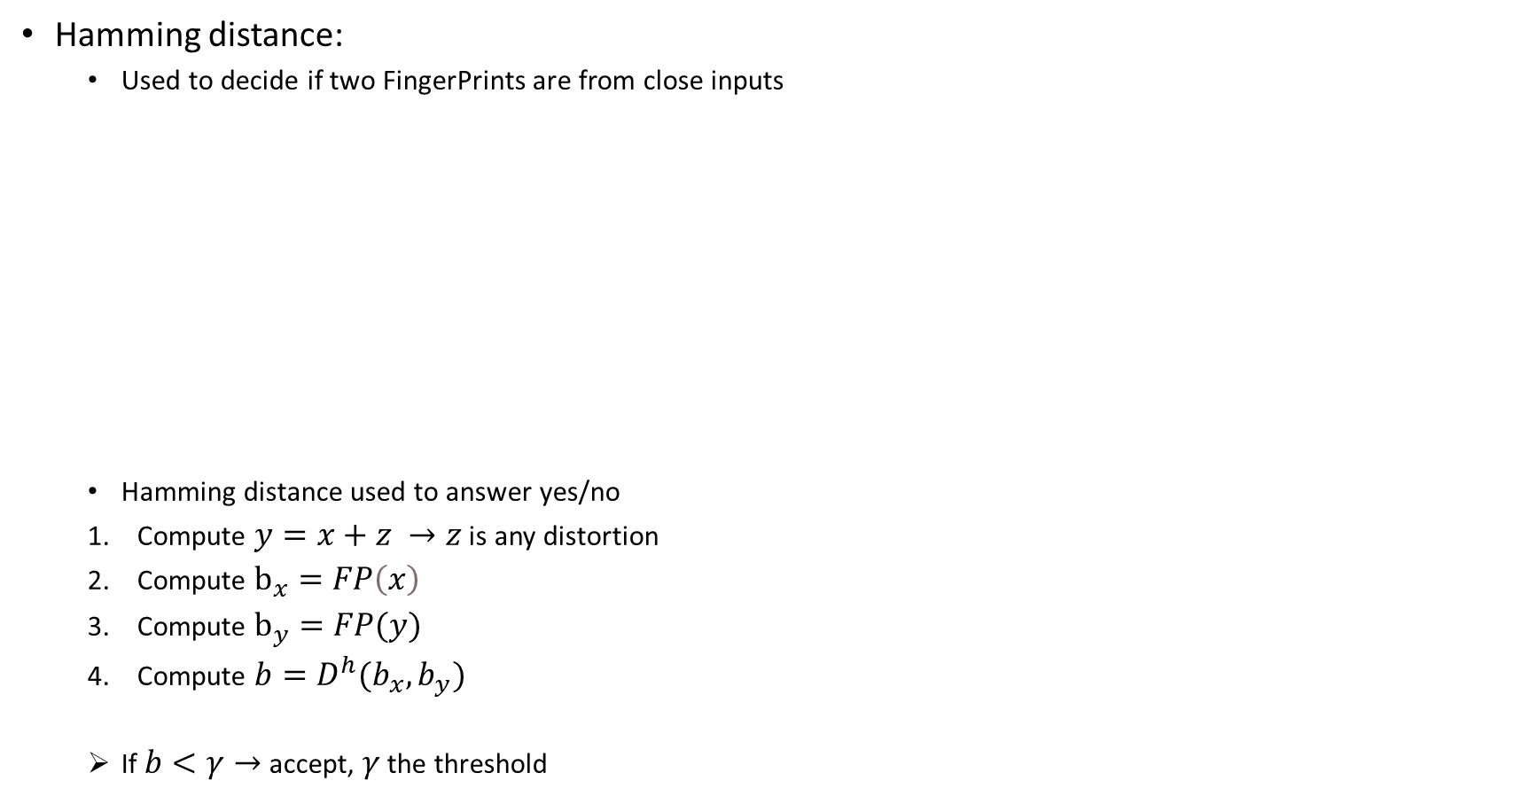
(2.5)
Hamming distance:
Used to decide if two FingerPrints are from close inputs
Hamming distance used to answer yes/no
Compute $y=x+z →z$ is any distortion
Compute $b_{x}=FP\left(x\right)$
Compute $b_{y}=FP(y)$
Compute $b=D^{h}(b_{x}, b_{y})$
If $b<γ→$ accept, $γ$ the threshold
Notes:
19

Slide 20
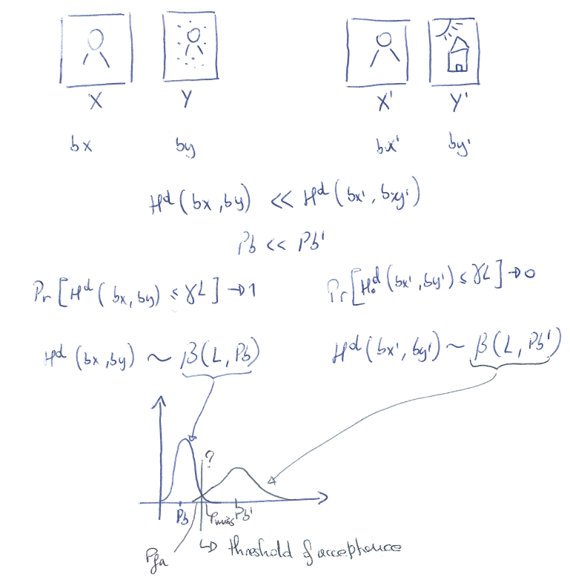
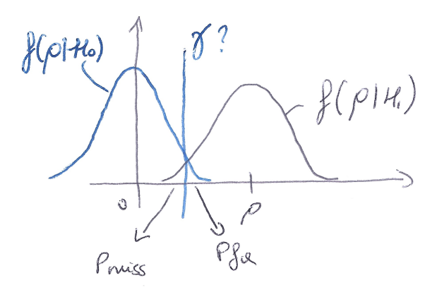
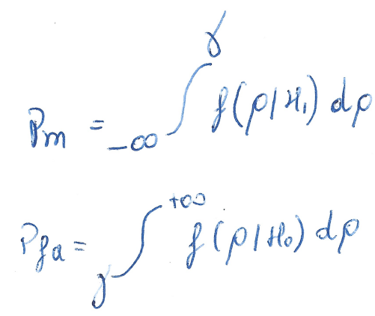
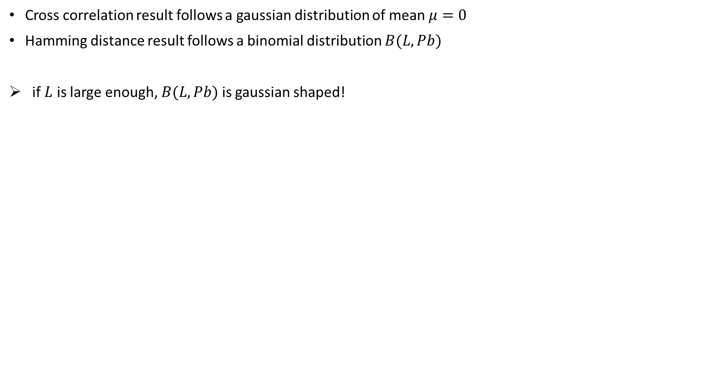
(2.5)
Cross correlation result follows a gaussian distribution of mean $μ=0$
Hamming distance result follows a binomial distribution $B(L, Pb)$
if $L$ is large enough, $B(L, Pb)$ is gaussian shaped!
Notes:
20

Slide 21
(2.6) Explain the main requirements to privacy protection. Provide several examples of privacy protection schemes.
Lets assume you are a phone developer
You have a face unlocking functionality
It takes pictures of the users face to authenticate them
Should you store the users real face ?
You are always at risk of data breaches !

Slide 22
(2.6)
By having your users images/photos, someone could:
Create silicone masks that are real enough to trick computer vision
Sell private information to insurances (by analysing face details freckles/irises)
…
The goal is not needing to store real data, but still offer the possibility of face unlocking
To achieve this, we look at cryptographic hashing functions!
They can take as input any data length
Output is smaller than input (easier to store)
From the output you cant compute input (safe in event of data breaches)
Notes:
22

Slide 23
(2.6)
The only problem is that if you move your face in the slightest, the output hash will be completely different!
So you wont be able to compare two ashes to decide whether or not it is the same person in two different pictures
Solution -> use fingerprinting hashes:
All the same properties as cryptographic hashing
But 2 slightly different images, will have the same or almost the same fingerprint hash
With this method, you get the best of both worlds, security while keeping costumers happy
Notes:
23

